Slide 1
Reading & inspecting data in R

Slide 2
R can read and write data from a multitude of different sources
Text (csv, tsv, …)
Stata
SPSS
SAS
Excel
…
And using lots of different packages and functions

Slide 3
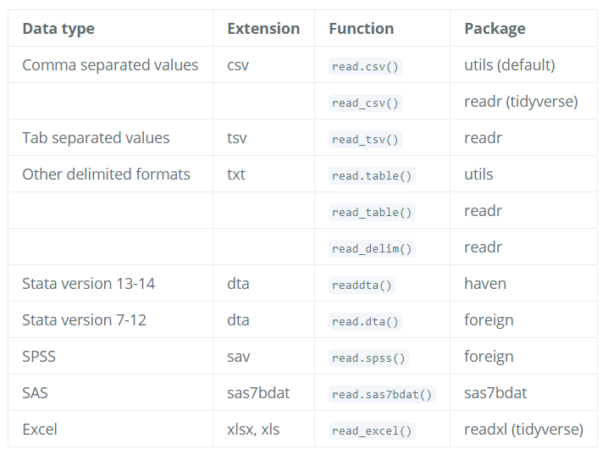

Slide 4
raw -> technically correct data
read.table and its cousins (utils package)
read.csv: comma separated values with period as decimal separator.
read.csv2: semicolon separated values with comma as decimal separator.
read.delim: tab-delimited files with period as decimal separator.
read.delim2: tab-delimited files with comma as decimal separator.
read.fwf: data with a predetermined number of bytes per column.

Slide 5

Example
Simple base R option

Slide 6

Downloading from the web
We can download data before reading it in to R
A common function for this is
E.g.
Can download from e.g. GitHub, figshare, googlesdrive, …
Notes:
We are going to use the R function download.file() to download the CSV file that contains the survey data from figshare, and we will use read.csv() to load into memory the content of the CSV file as an object of class data.frame. Inside the download.file command, the first entry is a character string with the source URL (“https://ndownloader.figshare.com/files/2292169”). This source URL downloads a CSV file from figshare. The text after the comma (“data/portal_data_joined.csv”) is the destination of the file on your local machine. You’ll need to have a folder on your machine called “data” where you’ll download the file. So this command downloads a file from figshare, names it “portal_data_joined.csv,” and adds it to a preexisting folder named “data.”

Slide 7
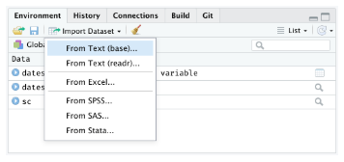
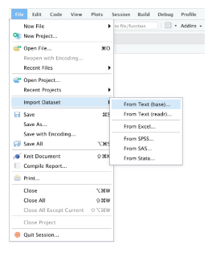
Via GUI
3 categories
Text data
Excel data
Statistical data
Options
Environment pane
File menu

Slide 8
Importing using readr
Provides support for
Import from the file system or a url
Change column data types
Skip or include-only columns
Rename the data set
Skip the first N rows
Use the header row for column names
Trim spaces in names
Change the column delimiter
Encoding selection
Select quote, escape, comment and NA identifiers

Slide 9
Using stringsAsFactors=FALSE
By default, when building or importing a data frame, the columns that contain characters (i.e. text) are coerced (= converted) into factors. Depending on what you want to do with the data, you may want to keep these columns as character. To do so, read.csv() and read.table() have an argument called stringsAsFactors which can be set to FALSE.
In most cases, it is preferable to set stringsAsFactors = FALSE when importing data and to convert as a factor only the columns that require this data type.

Slide 10
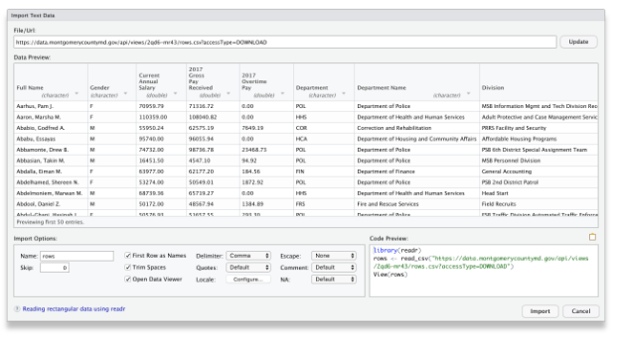
Example
https://support.rstudio.com/hc/en-us/articles/218611977-Importing-Data-with-RStudio
import form data.gov (paste https://data.montgomerycountymd.gov/api/views/2qd6-mr43/rows.csv?accessType=DOWNLOAD

Slide 11
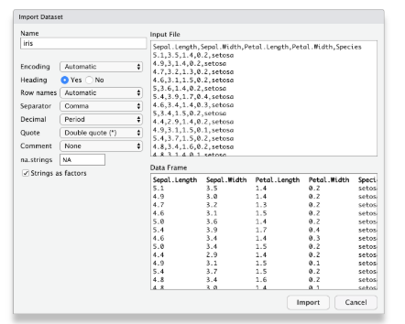
Importing data from Text files

Slide 12
Importing data from Excel files
The Excel importer provides support to:
Import from the file system or a url
Change column data types
Skip columns
Rename the data set
Select an specific Excel sheet
Skip the first N rows
Select NA identifiers

Slide 13
Example
For example, one can import with ease an xls file from data.gov by pasting this url
http://www.fns.usda.gov/sites/default/files/pd/slsummar.xls
selecting "Update".

Slide 14
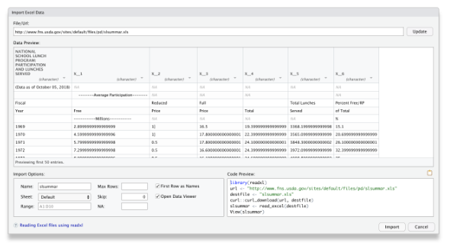

Slide 15
We can clean this up by
skipping 6 rows from this file
unchecking the "First Row as Names" checkbox.
The file is looking better but some columns are being displayed as strings when they are clearly numerical data.
We can fix this by selecting "numeric" from the column dropdown.
The final step is to click "Import" to run the code under "Code Preview" and import the data into RStudio, the final result should look as follows:

Slide 16
.RData, .Rda, .Rds
Store R objects with properties
.Rda is just a short name for .Rdata
save(), load(), attach(),…
.Rds use to restore R object with different name
readRDS(), saveRDS(),…

Slide 17
Inspecting data structure
Once data is read-in there are several way to view and interrogate them
The most simple is to type the name of the variable
Can you see any problems with this?

Slide 18
Other options
View the top of the data
head(<name>)
Equivalently we can use
tail(<name>)

Slide 19
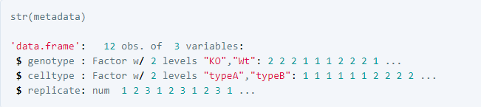
Compact display of contents
The head and tail are limited in terms of information
A good overall summary in base R is
str(<name>)

Slide 20
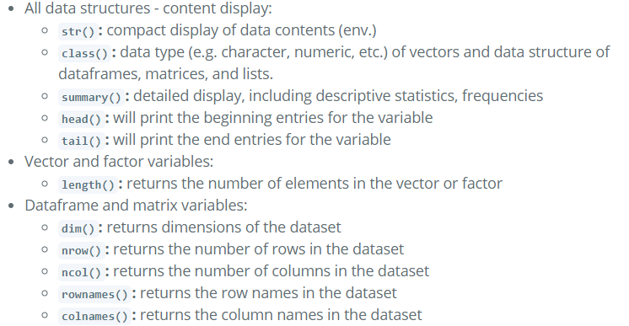
List of some data inspection functions

Slide 21
Viewing data
You can view the data (when data frame, matrix etc) in the data panel in several ways:
View(<name>)
Edit(<name>)
Left click with the mouse on the name of the variable in the Environment tab
Hover over the variable name in the console or scripts and press F2

Slide 22
Writing to Excel
Format, styling and editing inside of R
library(openxlsx)
l <- list(iris = iris, mtcars = mtcars, chickwts = chickwts, quakes = quakes)
openxlsx::write.xlsx(l, file="datasets.xlsx")
Much more fancy features
E.g.
https://cran.r-project.org/web/packages/openxlsx/vignettes/formatting.pdf

Slide 23
